Slide 1
Local & Global Variable

Slide 2

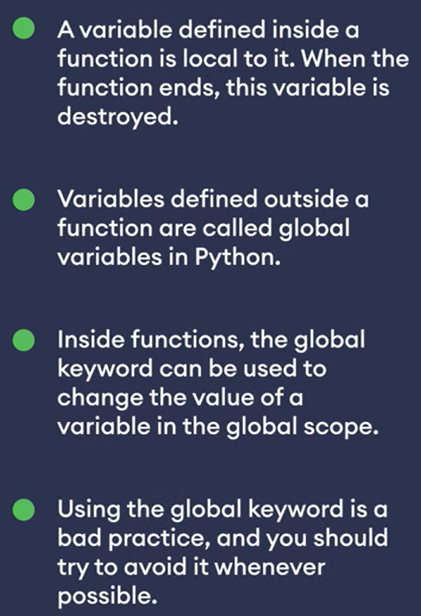


Local Variable
Local & Global Variables

